Slide 1

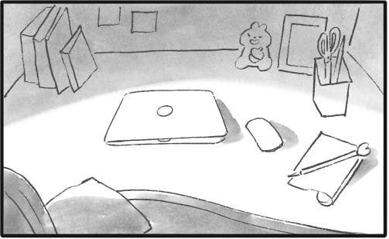
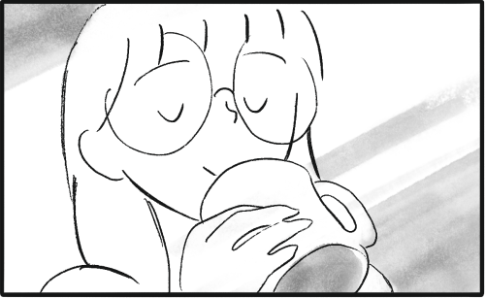
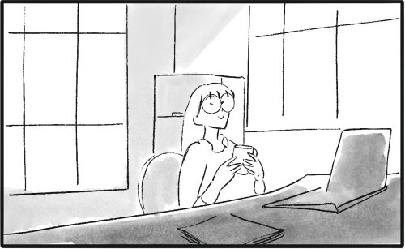
Zero-shot Generation of Coherent Storybook from Plain Text Story using Diffusion Models

Slide 2
Problem Statement
Large-scale text-to-image models focus on generating individual images, but real-world applications like storytelling require coherent image sequences.

Slide 3
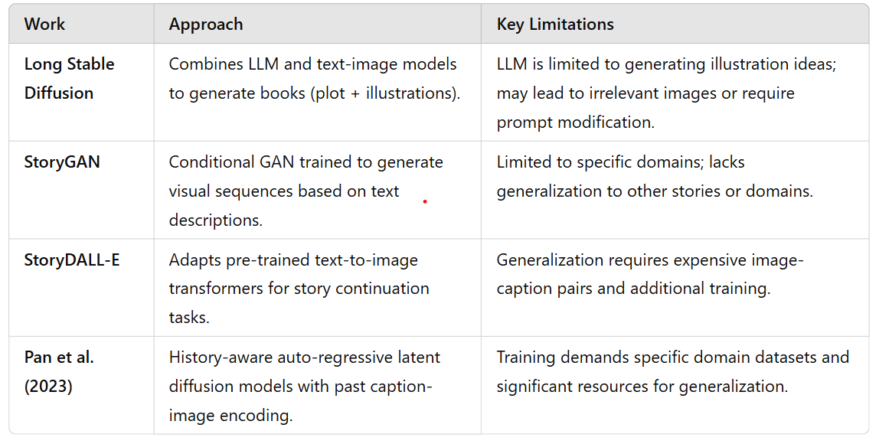
Prior Work

Slide 4
The proposed solution
Develop a training-free pipeline for coherent storybook generation.
Achieved using:
Textual inversion
Detector-based semantic image editing

Slide 5
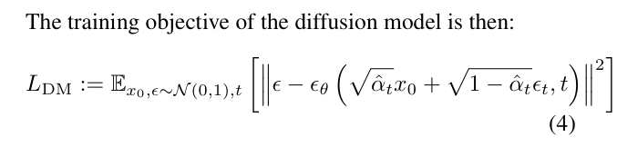

Diffusion model
Adding noise
Reversing the noise
Learning to draw a butterfly (Analogy)

Slide 6
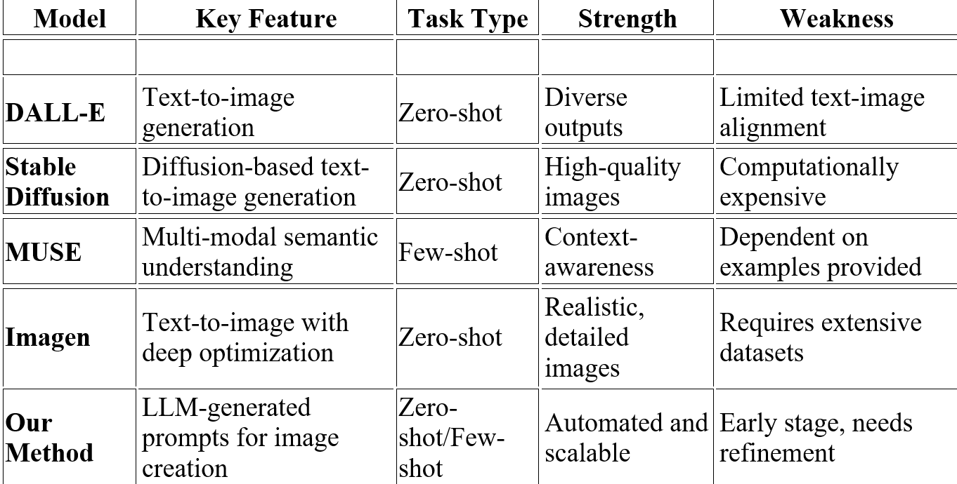
Related Works

Slide 7
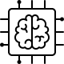





Methodology
-Generate prompts by providing instructions to LLM along with text of a story .
-Utilize Diffusion-based Tex-to-Image model to generate initial images from the set of prepared prompts.
-Apply Face Restoration on the initial images.
-Find the textual embeddings of a specific identity by Textual Inversion learning .
-Use the obtained textual embeddings to preform Iterative Coherent Identity Injection on enhanced images.

Slide 8
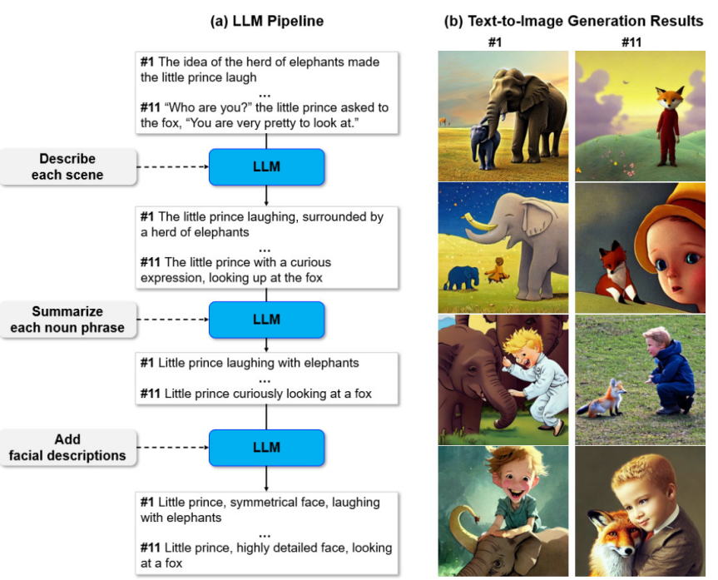



Slide 9
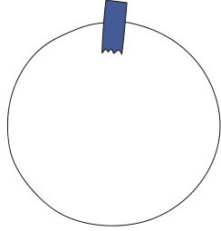







Prompt Generation 1/3
Issue Appeared!
Text-to-Image models struggle to effectively handle of the output!!!
Plain Text of The Story
“The idea of the herd of elephants made the little prince laugh”
LLM
The LLM expresses its creativity in this step
The strength of the creativity controlled by the temperature parameter T
the output
1st Instruction
The little prince laughing, surrounded by a herd of elephants
Describe each scene

Slide 10
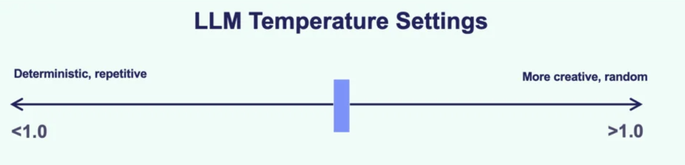

Slide 11
Prompt Generation 2/3
Enhance Quality!
By using the magic words
such as “Highly detailed” and “insanely intricate”
The output 1
The little prince laughing, surrounded by a herd of elephants
LLM
The LLM summarize the output of the previous step
The output 2
2nd Instruction
The little prince laughing with elephants
Summarize each noun phrase

Slide 12
Prompt Generation 3/3
Style Modifiers!
generate different versions of the story by simply altering the style modifiers used.
The output 2
The little prince laughing, surrounded by a herd of elephants
LLM
The LLM expresses its creativity again in this step
The output 3
3rd Instruction
If the main subject of the prompt is a person, add facial descriptions such as ‘symmetrical face’ or ‘beautiful eyes
Enhanced the realism of the generated images

Slide 13
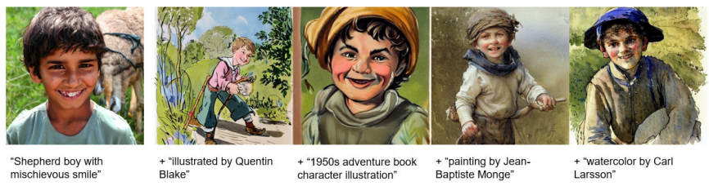

Slide 14


Initial Image Generation using Latent Diffusion Models
01
02
Traditional Diffusion Models
Latent
Diffusion Models
These models work by gradually adding noise to an image until it becomes random noise, and then learning how to reverse this process to generate a clean image from noise. This is done directly in the pixel space, i.e., the raw image itself.
Instead of working in the pixel space (which can be computationally expensive), LDMs operate in a lower-dimensional latent space. Latent space represents the image in a compressed form, which helps make computations more efficient.

Slide 15
Initial Image Generation using Latent Diffusion Models
01
02
Encoder
Decoder
compresses the image into this latent space
z = E(x)
reconstructs the image from the latent representation.
x˜ = D(z)

Slide 16



Loss of Latent Diffusion Models
Tθ(y) be a model that maps a conditioning input y into a conditioning vector.
t is the time step
zt is latent image representation noised to time t
ε is the unscaled noise sample
ε(θ) is the denoising network
We aim to correctly remove the noise added to a latent representation of an image. While training, c(θ) and ε(θ)are jointly optimized to minimize the LDM loss.

Slide 17

Iterative Coherent Identity Injection
Where the magic of consistency happens
The Problem
When we generate images for a story using AI, the main character’s face may not look the same across all scenes. For example, in one picture, they might have different facial features or expressions, which breaks the flow of the story.

Slide 18
Iterative Coherent Identity Injection
Where the magic of consistency happens
Start with the initial image.
Learn the Target Identity.
Iterative refinement:
- Isolate the Face
-Add Noise and Denoise
-Keep the Background
-Refine, Refine, Refine

Slide 19
Iterative Coherent Identity Injection
1. Isolate the Face
-A face detector is used to identify where the face is in the image.
-A mask is created that highlights only the face, telling the model, "Focus here!" while leaving the rest of the image untouched.

Slide 20
Iterative Coherent Identity Injection
2. Compress the Image
The masked image is encoded into something called the latent space using a Variational Autoencoder (VAE).
The latent space is like a simplified, compressed version of the image, making it easier for the model to work with.
Think of it as zipping a large file to make it manageable.

Slide 21
Iterative Coherent Identity Injection
3. Add Noise and Denoise
Add Noise: The model scrambles the latent image by adding random noise.
This might seem counterintuitive, but it’s a way for the model to "start fresh" and improve the image step by step.
Denoise: Using:
The target identity's text embedding (the "digital fingerprint" of the character's face).
The facial mask to focus only on the face.
The model begins cleaning up the noise, gradually revealing a clearer, refined face.

Slide 22
Iterative Coherent Identity Injection
4. Keep the Background
While working on the face, the model ensures the background and non-facial parts of the image stay the same.
After each step of denoising, the original background is pasted back into the image, preserving the scene.

Slide 23
Iterative Coherent Identity Injection
5. Refine, Refine, Refine
The denoising process doesn’t happen all at once—it’s done in cycles:
Each cycle produces a slightly improved image.
The result of one cycle is fed back as the input for the next cycle.
This gradual refinement ensures smooth blending of the character’s face with the rest of the image.

Slide 24
Iterative Coherent Identity Injection
More Cycles = Stronger Target Identity
Fewer Cycles = Subtle Changes
For example:
In a storybook, you might want a strong, recognizable identity for the main character (many cycles).
For background characters or subtle changes, fewer cycles might be better.

Slide 25

Iterative Coherent Identity Injection
Outcome
At the end of this process:
The character's face is refined to match the target identity.
The changes look natural and seamless.
The scene and background remain untouched.

Slide 26
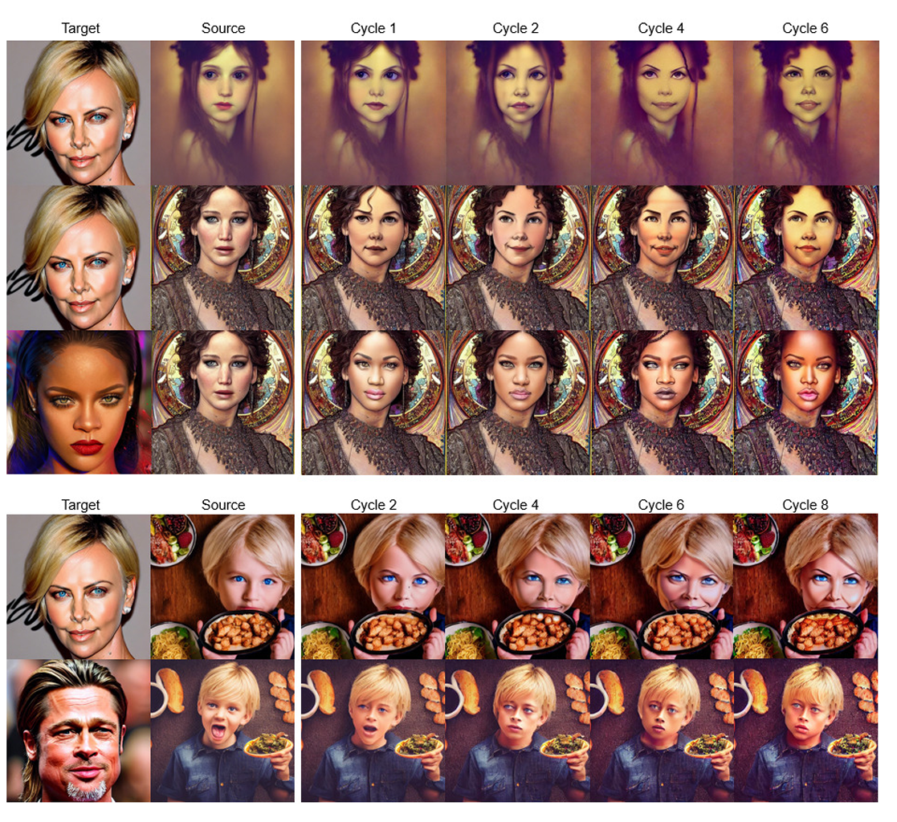

Slide 27
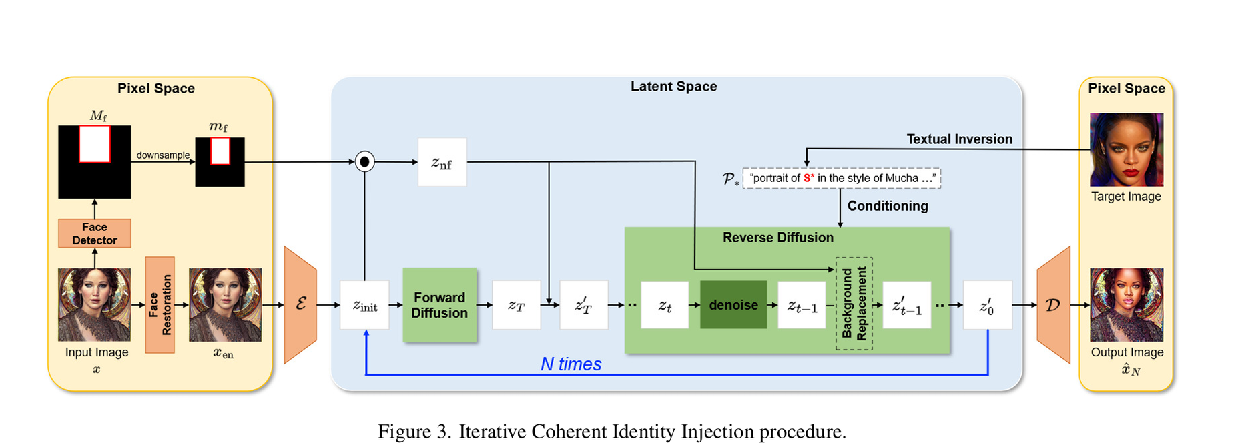
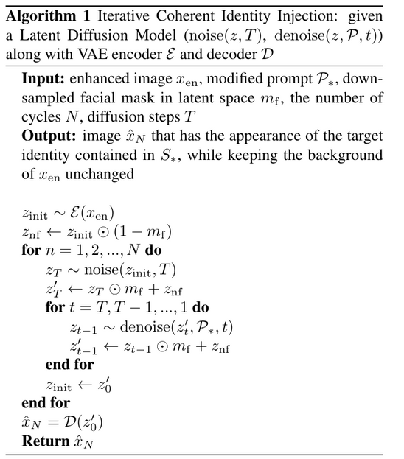

Slide 28
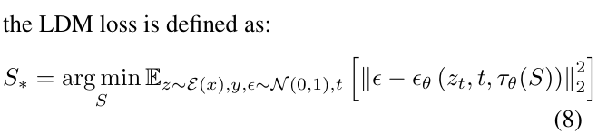
prompt by LLM: The little boy is looking at the sea
Add a placeholder S: S is looking at the sea
Optimize S to learn a target identity -> S*
Optimized prompt P*: S* is looking at the sea
The goal of this equation is to learn an accurate digital representation of the target identity (S*) within the text embedding space, enabling the model to consistently apply this identity when generating or modifying images

Slide 29
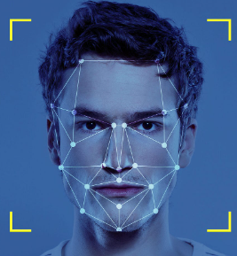
Implementation Details
Implementation choices
GPT-3 model , ”text-davinci-003"
ChatGPT
Stable Diffusion model(v1.5) (trained on LAION-5B dataset)
RetinaFace (face detector)
CodeFormer (face restoration)
RetinaFace

Slide 30


GPU of Quadro
RTX 6000
DDIM scheduler
fidelity weight
0.5
scale guidance
7.5 - 10
100 reverse
diffusion step

Slide 31
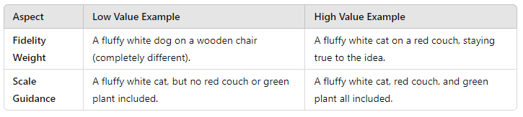
Input: ”A fluffy white cat on a red couch with a green plant in the background."
Fidelity Weight controls general similarity.
Scale Guidance ensures specific details are included.

Slide 32
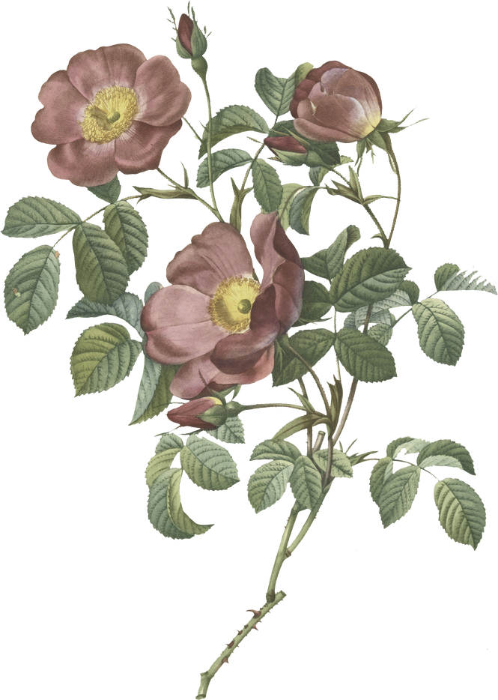
Coherent Identity Injection Cycles
One Cycle: 50 forward and reverse diffusion steps
1 Cycle ------> Single Adjusment to maintain character identity
8 Cycles----->Adjusment process multiple times

Slide 33
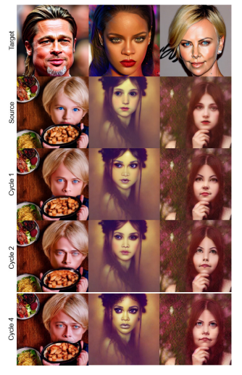

As the number increases,
the injected target
identity becomes
more apparent in
the output image.

Slide 34
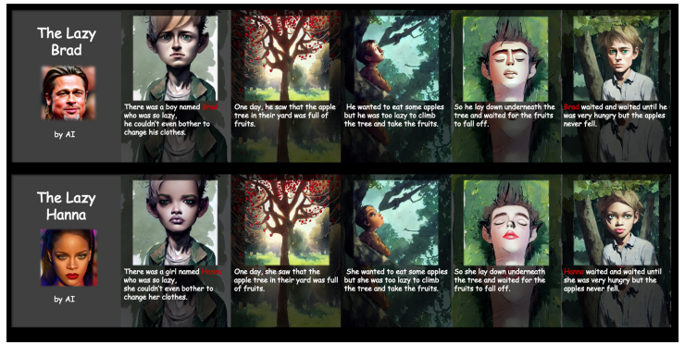

Slide 35
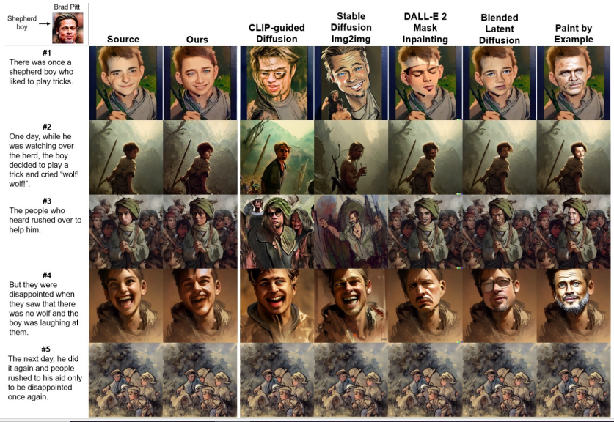

Slide 36

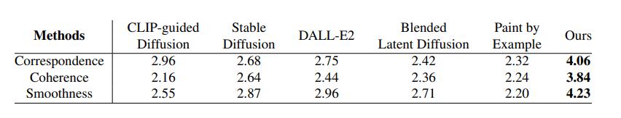
Quantitative Results

Slide 37
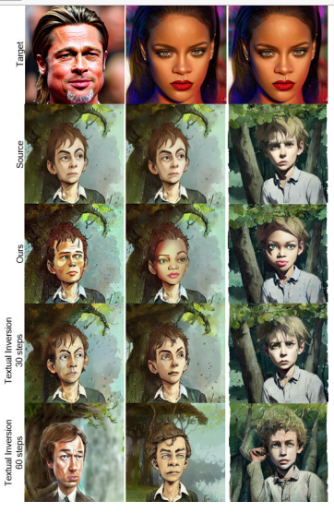
Comparison with Textual Inversion method.
Textual embedding guided image synthesis fails to preserve the background of the source images.

Slide 38

Conclusion
The paper introduces a new approach to generating storybook images that use large language models to guide the process, with a focus on maintaining character identity and background details. The proposed method performs better than existing approaches in terms of consistency and preserving background elements in the generated images.

